Slide 1

List, Tuple, Slicing
Trying to remember, I missed-out on buying the eggs; I better list 'em down the next time!
Prathmesh Palande
Pratik Loya
TOC EUS Automation
May 14, 2019

Slide 2
Section 1
Strings, Lists, Tuples, & Slicing

Slide 3
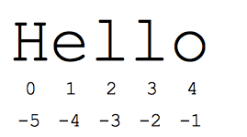

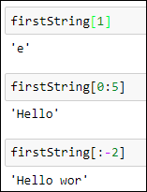
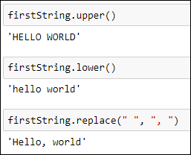
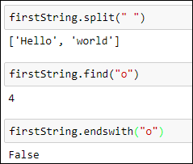
Strings
String – immutable and ordered sequence of characters
Sample Methods:
count
index
capitalize
split
endswith
find
replace
islower
isupper
lower
upper
lstrip
rstrip
strip

Slide 4


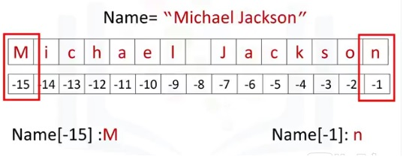
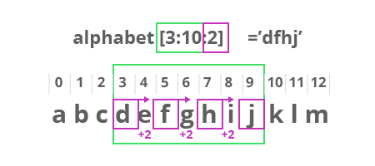
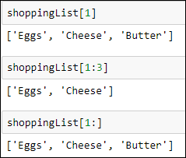
Lists
- ordered and mutable(changeable) collection of items
- allows duplicate members.
Create a list:
Accessing/Slicing items:

Slide 5



List Operations
Methods:
index(): returns the position at the first occurrence of the specified value.
append(): appends an element to the end of the list.
count() : Returns the number of elements with the specified value.
extend() : add the elements of a list (or any iterable), to the end of the current list

Slide 6
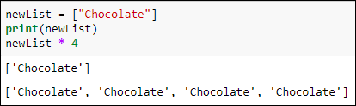



List Operations
Methods:
insert() : adds an element at the specified position
remove() : Removes the item with the specified value
pop() : Removes the element at the specified position
clear() : Removes all the elements from the list
sort() : Sorts the list
Operators:
+
*

Slide 7
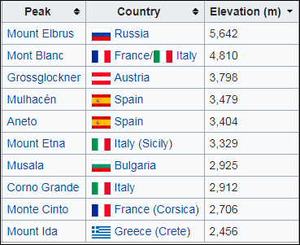


Tuples
- ordered and immutable (unchangeable) collection of items
- allows duplicate members
- to add or remove items, you must redeclare
-Example uses of tuples
Country Names
Mountain Peaks
Ordered set of functions
var = (‘one’, 2, ‘three’, ‘banana’)
Accessing elements

Slide 8


Tuples Operations
Methods*:
count() : returns the number of times a specified value appears in the tuple.
index():
- finds the first occurrence of the specified value
- raises an exception if the value is not found.
*Operations which cause potential changes to a tuple are not permissible; reinforce the idea of immutability

